Slide 1

Neural Networks and Deep Learning Perceptron
Presented by
Dr. T. Hitendra Sarma
Associate Professor
Department of Information Technology
Vasavi College of Engineering, Hyderabad

Slide 2

The Perceptron Algorithm
The slides are mainly from Vivek Srikumar
1

Slide 3
Outline
The Perceptron Algorithm & Convergence
3

Slide 4
Recall: Linear Classifiers
Input is a n dimensional vector x
Output is a label y ∈ {-1, 1}
Linear Threshold Units (LTUs) classify an example x using the following classification rule
Output = sgn(w^{T}x + b) = sgn(b +∑w_{i} x_{i})
w^{T}x + b ≥ 0 → Predict y = 1
w^{T}x + b < 0 → Predict y = -1
b is called the bias term
4

Slide 5








Recall: Linear Classifiers
Input is a n dimensional vector x
Output is a label y ∈ {-1, 1}
Linear Threshold Units (LTUs) classify an example x using the following classification rule
sgn
∑
– Output = sgn(w^{T}x + b) = sgn(b +∑w_{i} x_{i})
– w^{T}x + b ¸ 0 ) Predict y = 1
– w^{T}x + b < 0 ) Predict y = -1
b is called the bias term
𝑤₁ 𝑤₍ 𝑤₎ 𝑤*
𝑥₁ 𝑥₍ 𝑥₎ 𝑥*
𝑤₊ 𝑤₆ 𝑤₇
𝑥₊ 𝑥₆ 𝑥₇
𝑤₈ 𝑏
𝑥₈ 1
5

Slide 6















Learning the perceptron
1
1
2
2
3
.
+
x₂
3
.
x₁
N
N
Given a number of input output pairs, learn the weights and bias
N
i=1
i i
–
– Learn
1
N
, given several
pairs
32

Slide 7
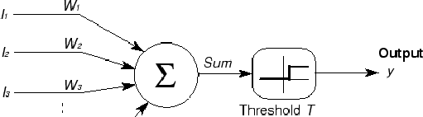




The perceptron
x₁
x₂ x₃
x_{N}
x_{N+1}=1
^{W}N+1
Restating the perceptron equation by adding another dimension to
N+1
i i
i=1
where
N+1
Note that the boundary
N+1
i=1
i i
is now a hyperplane through origin
33

Slide 8



The geometry of a linear classifier
sgn(b +w₁ x₁ + w₂x₂)
b +w₁ x₁ + w₂x₂=0
We only care about the sign, not the magnitude
+ +₊+₊
+ +
+
[w₁ w₂]
x₁
- -
₋₋ - ₋-⁻ -
In n dimensions, a linear classifier
represents a hyperplane that separates the space into two half-spaces
--₋₋ -
- ₋ ₋
x₂
8

Slide 9
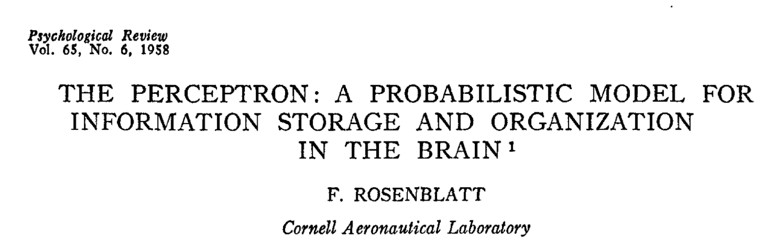
The Perceptron
9

Slide 10
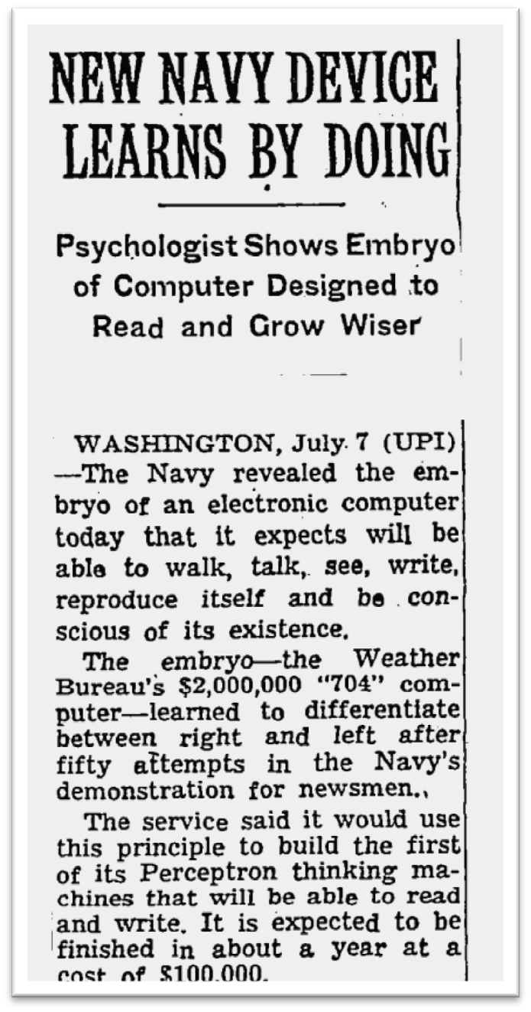
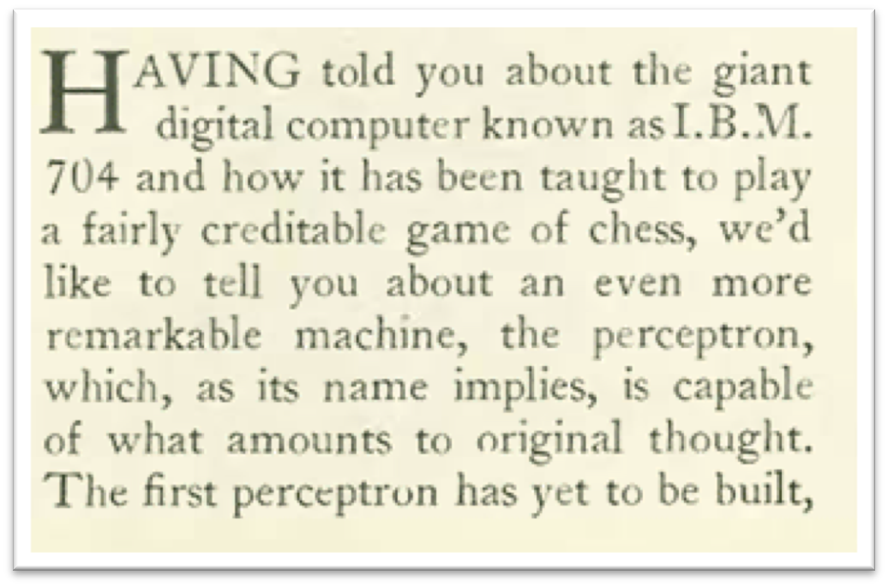
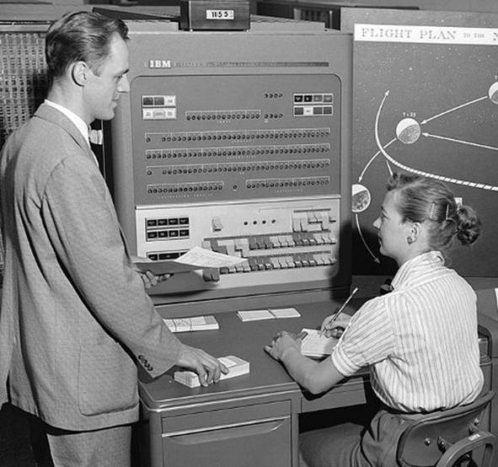
The hype
The New Yorker, December 6, 1958 P. 44
The New York Times, July 8 1958
The IBM 704 computer
8

Slide 11
The Perceptron algorithm
Rosenblatt 1958
The goal is to find a separating hyperplane
For separable data, guaranteed to find one
An online algorithm
Processes one example at a time
Several variants exist (will discuss briefly at towards the end)

Slide 12
The Perceptron algorithm
Input: A sequence of training examples (x₁, y₁), (x₂, y₂),! where all x_{i} ∈ ℜ^{n}, y_{i} ∈ {-1,1}
Initialize w₀ = 0 ∈ ℜ^{n}
For each training example (x_{i}, y_{i}):
Predict y’ = sgn(w_{t}^{T}x_{i})
If y_{i} ≠ y’:
Update w_{t+1} ←w_{t} + r (y_{i} x_{i})
Return final weight vector

Slide 13
The Perceptron algorithm
Input: A sequence of training examples (x₁, y₁), (x₂, y₂),! where all x_{i} ∈ ℜ^{n}, y_{i} ∈ {-1,1}
Remember: Prediction = sgn(w^{T}x)
There is typically a bias term also (w^{T}x + b), but the bias may be treated as a constant feature and folded into w
Initialize w₀ = 0 ∈ ℜ^{n}
For each training example (x_{i}, y_{i}):
– Predict y’ = sgn(w ^{T}x )
t i
If y_{i} ≠ y’:
Update w
←w_{t} + r (y_{i} x_{i})
t+1
Return final weight vector

Slide 14
The Perceptron algorithm
Input: A sequence of training examples (x₁, y₁), (x₂, y₂),! where all x_{i} ∈ ℜ^{n}, y_{i} ∈ {-1,1}
Remember: Prediction = sgn(w^{T}x)
There is typically a bias term also (w^{T}x + b), but the bias may be treated as a constant feature and folded into w
Initialize w₀ = 0 ∈ ℜ^{n}
For each training example (x , y ):
i i
– Predict y’ = sgn(w ^{T}x )
t i
If y_{i} ≠ y’:
Update w
←w_{t} + r (y_{i} x_{i})
t+1
Return final weight vector
Footnote: For some algorithms it is mathematically easier to represent False as -1, and at other times, as 0. For the Perceptron algorithm, treat -1 as false and +1 as true.
12

Slide 15
The Perceptron algorithm
Input: A sequence of training examples (x₁, y₁), (x₂, y₂),! where all x_{i} ∈ ℜ^{n}, y_{i} ∈ {-1,1}
Mistake on positive: w_{t+1} ← w_{t} + ry_{i}x_{i}
Mistake on negative: w_{t+1} ← w_{t} - ry_{i}x_{i}
Initialize w₀ = 0 ∈ ℜ^{n}
For each training example (x_{i}, y_{i}):
Predict y’ = sgn(w_{t}^{T}x_{i})
If y_{i} ≠ y’:
Update w_{t+1} ←w_{t} + r (y_{i} x_{i})
Return final weight vector

Slide 16
The Perceptron algorithm
Input: A sequence of training examples (x₁, y₁), (x₂, y₂),! where all x_{i} ∈ ℜ^{n}, y_{i} ∈ {-1,1}
Mistake on positive: w_{t+1} ← w_{t} + ry_{i}x_{i}
Mistake on negative: w_{t+1} ← w_{t} - ry_{i}x_{i}
Initialize w₀ = 0 ∈ ℜ^{n}
For each training example (x_{i}, y_{i}):
r is the learning rate, a small positive number less than 1
– Predict y’ = sgn(w ^{T}x )
t i
If y_{i} ≠ y’:
Update w_{t+1} ←w_{t} + r (y_{i} x_{i})
Return final weight vector

Slide 17
The Perceptron algorithm
Input: A sequence of training examples (x₁, y₁), (x₂, y₂),! where all x_{i} ∈ ℜ^{n}, y_{i} ∈ {-1,1}
Mistake on positive: w_{t+1} ← w_{t} + ry_{i}x_{i}
Mistake on negative: w_{t+1} ← w_{t} - ry_{i}x_{i}
Initialize w₀ = 0 ∈ ℜ^{n}
For each training example (x_{i}, y_{i}):
r is the learning rate, a small positive number less than 1
– Predict y’ = sgn(w ^{T}x )
t i
If y_{i} ≠ y’:
Update w_{t+1} ←w_{t} + r (y_{i} x_{i})
Return final weight vector
Update only on error. A mistake- driven algorithm

Slide 18
The Perceptron algorithm
Input: A sequence of training examples (x₁, y₁), (x₂, y₂),! where all x_{i} ∈ ℜ^{n}, y_{i} ∈ {-1,1}
Mistake on positive: w_{t+1} ← w_{t} + ry_{i}x_{i}
Mistake on negative: w_{t+1} ← w_{t} - ry_{i}x_{i}
Initialize w₀ = 0 ∈ ℜ^{n}
For each training example (x_{i}, y_{i}):
r is the learning rate, a small positive number less than 1
– Predict y’ = sgn(w ^{T}x )
t i
If y_{i} ≠ y’:
Update w_{t+1} ←w_{t} + r (y_{i} x_{i})
Return final weight vector
Update only on error. A mistake- driven algorithm
This is the simplest version. We will see more robust versions at the end

Slide 19
The Perceptron algorithm
Input: A sequence of training examples (x₁, y₁), (x₂, y₂),! where all x_{i} ∈ ℜ^{n}, y_{i} ∈ {-1,1}
Mistake on positive: w_{t+1} ← w_{t} + ry_{i}x_{i}
Mistake on negative: w_{t+1} ← w_{t} - ry_{i}x_{i}
Initialize w₀ = 0 ∈ ℜ^{n}
For each training example (x_{i}, y_{i}):
r is the learning rate, a small positive number less than 1
– Predict y’ = sgn(w ^{T}x )
t i
If y_{i} ≠ y’:
Update w_{t+1} ←w_{t} + r (y_{i} x_{i})
Return final weight vector
Update only on error. A mistake- driven algorithm
This is the simplest version. We will see more robust versions at the end
Mistake can be written as y_{i}w_{t} x_{i} ≤ 0
T

Slide 20
Intuition behind the update
Mistake on positive: w_{t+1} ← w_{t} + r x_{i}
Mistake on negative: w_{t+1} ← w_{t} - r x_{i}
Suppose we have made a mistake on a positive example That is, y = +1 and w_{t}^{T} x <0
Call the new weight vector w_{t+1} = w_{t} + x (say r = 1)
The new dot product will be w_{t+1} x = (w_{t} + x) T x = w_{t} Tx + x x > w_{t} x
^{T}
For a positive example, the Perceptron update will increase the score assigned to the same input
Similar reasoning for negative examples

Slide 21


Mistake on positive: w_{t+1} ← w_{t} + r x_{i}
Mistake on negative: w_{t+1} ← w_{t} - r x_{i}
Geometry of the perceptron update
Predict
^{w}old

Slide 22

Mistake on positive: w_{t+1} ← w_{t} + r x_{i}
Mistake on negative: w_{t+1} ← w_{t} - r x_{i}
Geometry of the perceptron update
Predict
^{w}old
(x, +1)

Slide 23
Geometry of the perceptron update
Mistake on positive: w_{t+1} ← w_{t} + r x_{i}
Mistake on negative: w_{t+1} ← w_{t} - r x_{i}
Predict
^{w}old
(x, +1)
For a mistake on a positive example

Slide 24



Geometry of the perceptron update
Mistake on positive: w_{t+1} ← w_{t} + r x_{i}
Mistake on negative: w_{t+1} ← w_{t} - r x_{i}
Predict
Update
w ← w + x
^{w}old
(x, +1)
(x, +1)
For a mistake on a positive example

Slide 25

Geometry of the perceptron update
Mistake on positive: w_{t+1} ← w_{t} + r x_{i}
Mistake on negative: w_{t+1} ← w_{t} - r x_{i}
Predict
Update
w ← w + x
w
old
x
(x, +1)
(x, +1)
For a mistake on a positive example

Slide 26

Geometry of the perceptron update
Mistake on positive: w_{t+1} ← w_{t} + r x_{i}
Mistake on negative: w_{t+1} ← w_{t} - r x_{i}
Predict
Update
w ← w + x
w
old
x
(x, +1)
(x, +1)
For a mistake on a positive example

Slide 27



Geometry of the perceptron update
Mistake on positive: w_{t+1} ← w_{t} + r x_{i}
Mistake on negative: w_{t+1} ← w_{t} - r x_{i}
Predict
Update
After
w ← w + x
w
old
x
^{w}new
(x, +1)
(x, +1)
(x, +1)
For a mistake on a positive example

Slide 28

Geometry of the perceptron update
Predict
^{w}old

Slide 29
Geometry of the perceptron update
Predict
(x, -1) _{wold}
For a mistake on a negative example

Slide 30

Geometry of the perceptron update
Predict
Update
w ← w - x
(x, -1)
(x, -1)
- x
^{w}old
For a mistake on a negative example

Slide 31

Geometry of the perceptron update
Predict
Update
w ← w - x
(x, -1)
(x, -1)
- x
^{w}old
For a mistake on a negative example

Slide 32

Geometry of the perceptron update
Predict
Update
w ← w - x
(x, -1)
(x, -1)
- x
^{w}old
For a mistake on a negative example

Slide 33

Geometry of the perceptron update
Predict
Update
After
w ← w - x
(x, -1)
- x
^{w}new
(x, -1)
(x, -1)
^{w}old
For a mistake on a negative example

Slide 34
Perceptron Learnability
Obviously Perceptron cannot learn what it cannot represent
Only linearly separable functions
Minsky and Papert (1969) wrote an influential book demonstrating Perceptron’s representational limitations
Parity functions can’t be learned (XOR)
But we already know that XOR is not linearly separable
Feature transformation trick

Slide 35
Convergence
Convergence theorem
– If there exist a set of weights that are consistent with the data (i.e. the data is linearly separable), the perceptron algorithm will converge.

Slide 36
Convergence
Convergence theorem
If there exist a set of weights that are consistent with the data (i.e. the data is linearly separable), the perceptron algorithm will converge.
Cycling theorem
If the training data is not linearly separable, then the learning algorithm will eventually repeat the same set of weights and enter an infinite loop

Slide 37
Another Illustration - Perceptron

Slide 38






The Perceptron Problem
Find the hyperplane groups of points
N+1
i=1
that perfectly separates the two
i i
34

Slide 39



The Perceptron Problem
Find the hyperplane groups of points
N+1
i=1
that perfectly separates the two
i i
Note: _{1 2 N+1} is a vector that is orthogonal to the hyperplane
In fact the equation for the hyperplane itself means “the set of all Xs that are
orthogonal to 𝑊” (∑^{N+1} 𝑤_{i}𝑋_{i} = 𝑊^{T}𝑋 = 0)
i=1
35

Slide 40















Perceptron Learning Algorithm
Given
training instances
or
–
i
Using a +1/-1 representation for classes to simplify notation
Initialize
Cycle through the training instances:
While more classification errors
– For
𝑡𝑟𝑎𝑖𝑛
T
i
i
If
i
i
i i

Slide 41

Perceptron Algorithm: Summary
Cycle through the training instances
Only update on misclassified instances
If instance misclassified:
If instance is positive class
If instance is negative class

Slide 42




A Simple Method: The Perceptron Algorithm
+1 (blue)
-1(Red)
Initialize: Randomly initialize the hyperplane
– I.e. randomly initialize the normal vector
Classification rule
T
– Vectors on the same side of the hyperplane as and those on the other side will be assigned -1
The random initial plane will make mistakes
will be assigned +1 class,
38

Slide 43
Perceptron Algorithm
Initialization
+1 (blue)
-1(Red)
39

Slide 44
Perceptron Algorithm
+1 (blue)
-1(Red)
Misclassified positive instance
49

Slide 45
Perceptron Algorithm
+1 (blue)
-1(Red)

Slide 46
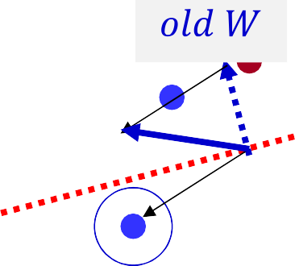
Perceptron Algorithm
Updated weight vector
Misclassified positive instance, add it to W

Slide 47

Perceptron Algorithm
+1 (blue)
-1(Red)
Updated hyperplane

Slide 48
Perceptron Algorithm
Misclassified instance, negative class
+1 (blue)
-1(Red)

Slide 49
Perceptron Algorithm
+1 (blue)
-1(Red)

Slide 50
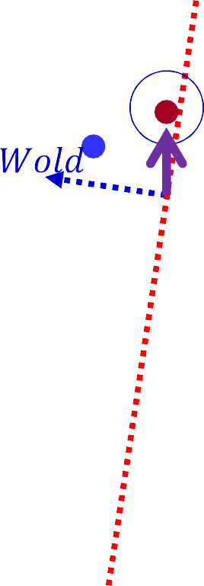
Perceptron Algorithm
+1 (blue)
-1(Red)
Misclassified negative instance, subtract it from W

Slide 51
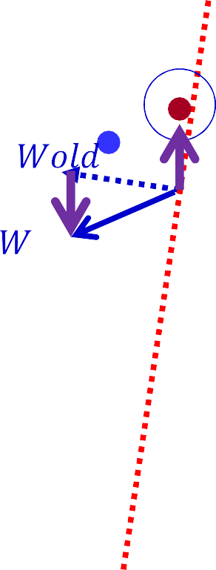
Perceptron Algorithm
-1(Red)
+1 (blue)
Updated hyperplane

Slide 52
Perceptron Algorithm
-1(Red)
+1 (blue)
Perfect classification, no more updates

Slide 53
Summary: Perceptron
Online learning algorithm, very widely used, easy to implement
Additive updates to weights
Geometric interpretation
You should be able to implement the Perceptron algorithm
Follow the tutorial : https://www.tutorialspoint.com/tensorflow/tensorflow_single_layer_perceptron.htm

